Slide 1


Health Care Update
April 11, 2022

Slide 2
OFFICE of the
STATE COMPTROLLER
Agenda
Status Updates
  Financials (Rae-Ellen)
  Partnership (Bernie)
  Communications (Betsy)
  Public Enrollment and Utilization Data Post (Josh)

Slide 3
OFFICE of the
STATE COMPTROLLER
Financials
FY 2021-2022 Year End Health Account Balances
Budget Review 3.15.22
Active Employee Healthcare Appropriation
Projected Appropriation Balance | $ 27,810,565.91
Active Employee Healthcare FAD Accounts
Projected Active Health FAD | $ 119,338,106.00
Projected Active Rx FAD | $ 30,606,515.31
Combined FAD Balances: | $ 149,944,621.31
Retired Employee Healthcare Appropriation
Projected Appropriation Balance | $ 3,387,174.31
Retired Employee Healthcare OPEB FAD Accounts
Projected Retiree Health | $ 148,035,541.85
Projected Retiree Rx | $ 47,492,219.53
Combined FAD Balances: | $ 195,527,761.38

Slide 4
OFFICE of the
STATE COMPTROLLER
Partnership
Partnership 2.0
As of 4/1/22 we have 154 groups enrolled totaling over 26,000 employees and almost 64,000 members.
As of 4/1/22, we had 106 groups who have completed their 3-year contract commitment under Partnership and had the option of leaving the plan without an early termination penalty. To date, no group has left Partnership 2.0.
We have a confirmed partial group joining on 7/1. We also received 3 - 7/1/22 applications for who are waiting to join pending the rate release.
Partnership 1.0
As of 4/1/22 we still have 5 groups remaining totaling approximately 2,400 employees and just under 3,400 members.

Slide 5

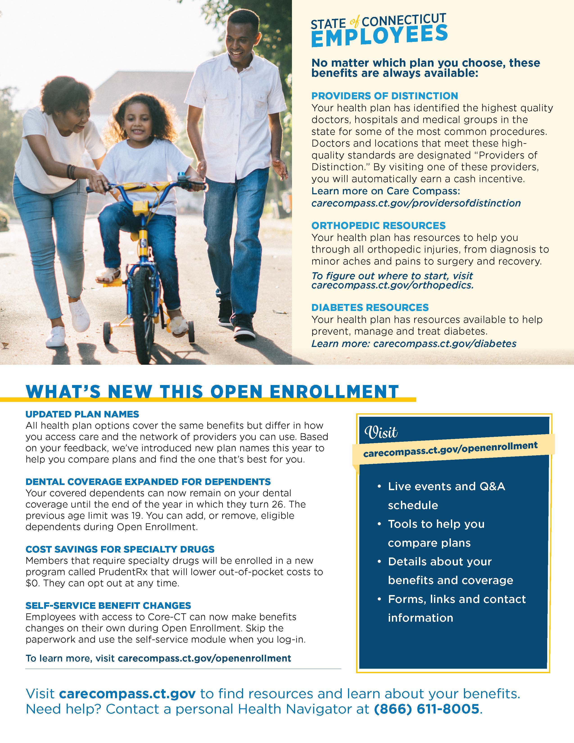
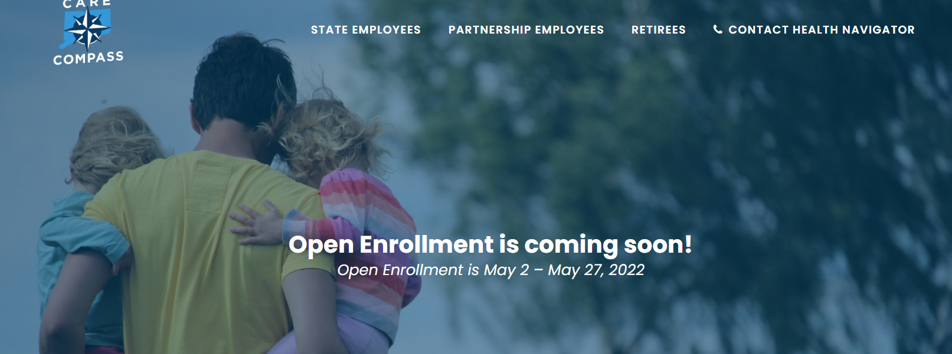
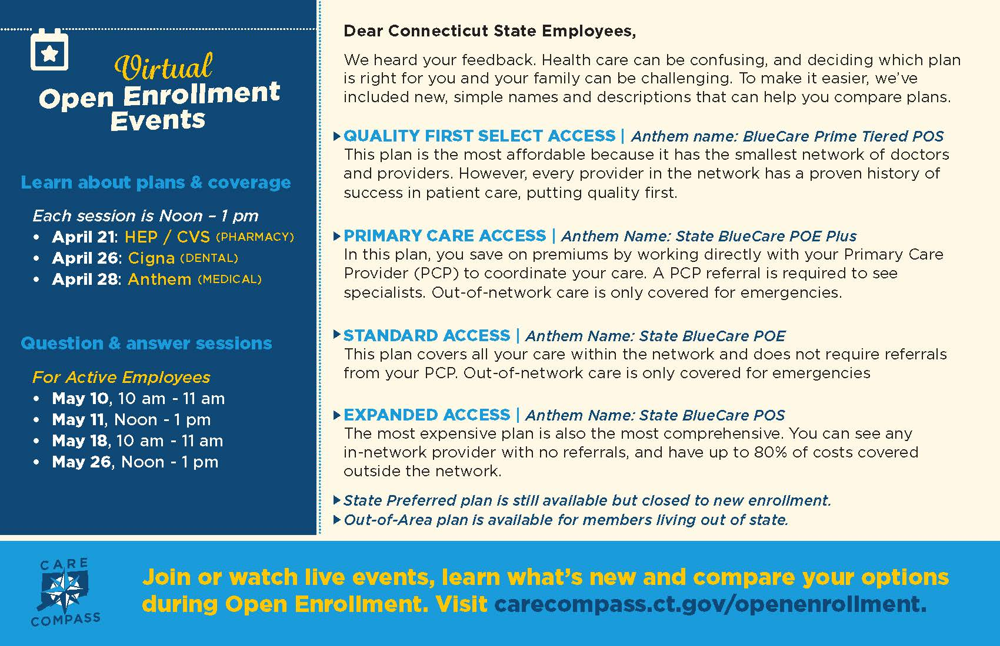
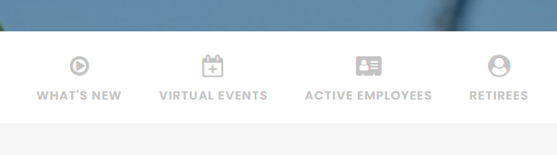

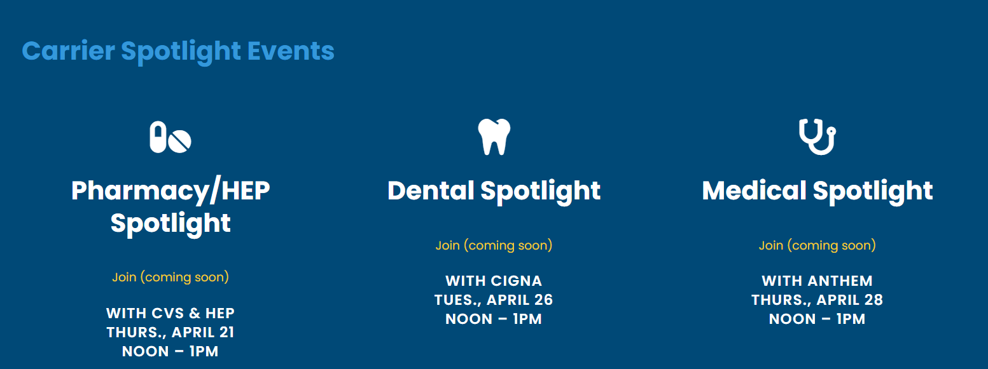
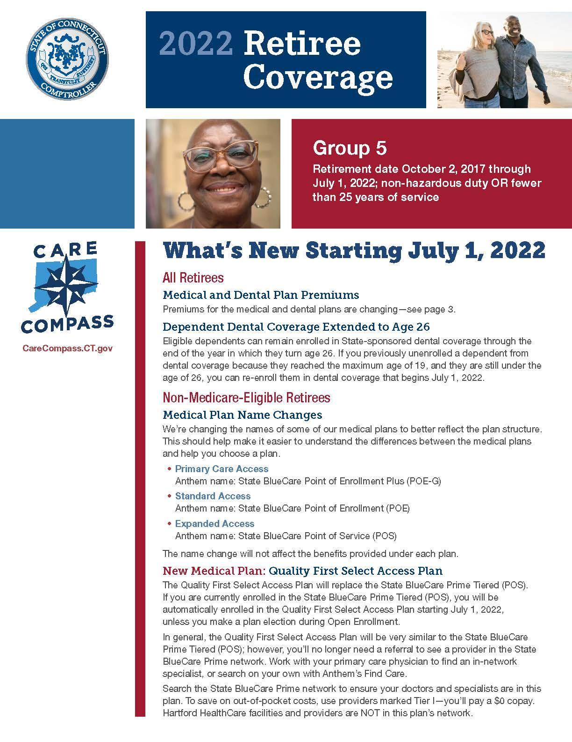
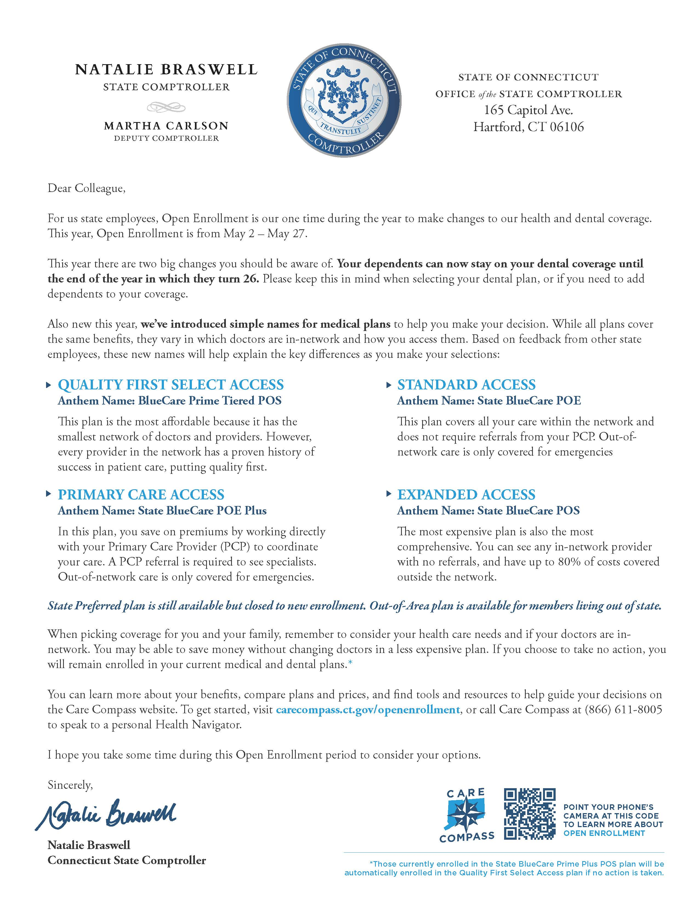
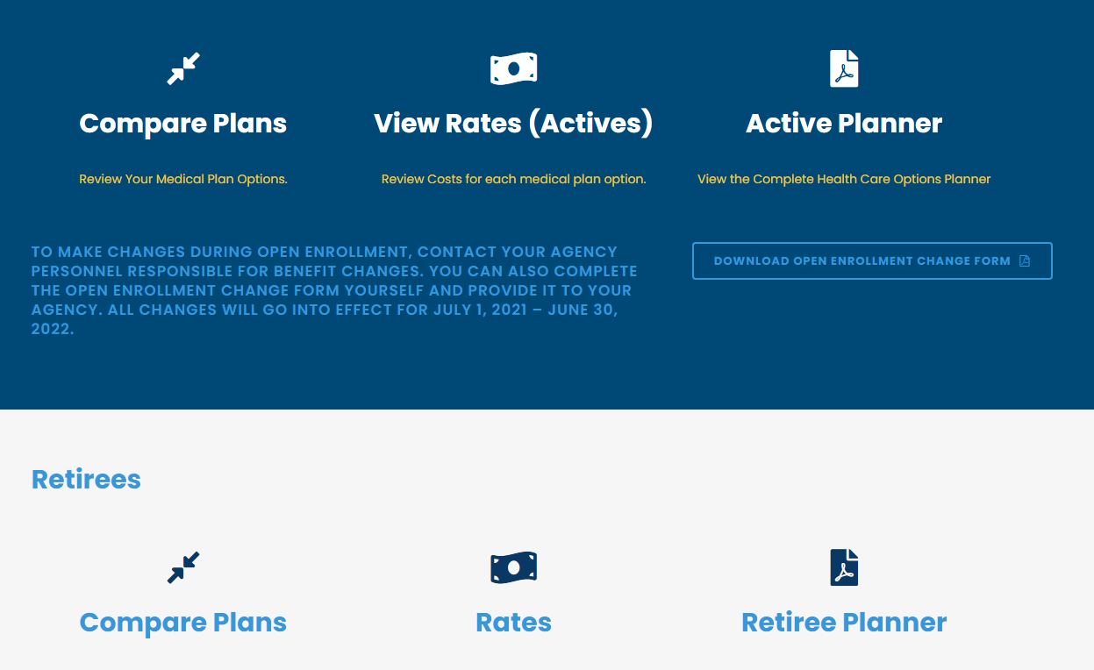
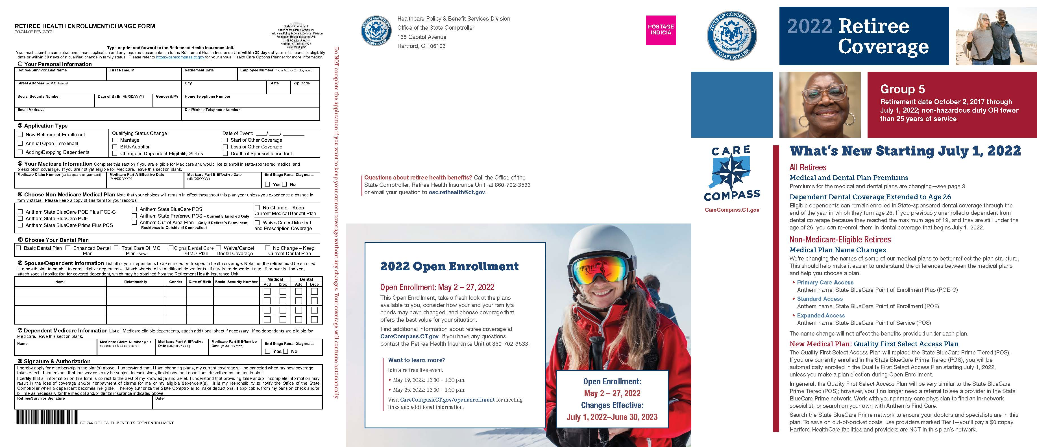
OFFICE of the
STATE COMPTROLLER
Open Enrollment Communications
Print/ Mailers:
New! Medical plan names
Postcard: Active employees / Pre 65 retirees
Bi-fold: active employees
New! OE information on comptroller letterhead to DOC employees
New! Retiree self-sealed (7 groups)
Digital content:
Virtual Carrier Spotlights (April)
CareCompass OE page (May)
New! Chatbot (in development)
New! Medical Plan Decision Tool (in development)
Active digital benefit planner (May)
New! Retiree digital benefit planner
Virtual Q & A meetings (May)
All-user emails with Open Enrollment content (April –May)
New! eBenefits enrollment/ benefit change option

Slide 6

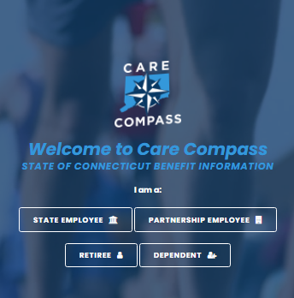
Care Compass Website Activity & Google Ads
OFFICE of the
STATE COMPTROLLER
Google Search Ads
Unique Visitors include people who visited CareCompass this month, plus anyone who visited in the previous month and then returned this month. Only 1 visit is counted if someone visits multiple times in a month.
New Visits are total number of visits in the month.

Slide 7


Social / Facebook Ads
OFFICE of the
STATE COMPTROLLER
Facebook reach is the number of unique people who see our content. It’s a measurement of our brand’s effective audience. Not every follower will see every single post.
Facebook impressions are defined as the number of times our ad was viewed on a user’s Facebook timeline. This is an important metric to track because it tells if our ads are compelling.
Facebook followers are people who have opted-in to “follow” our page, meaning that they will receive our updates in their timeline. The most common way to get followers is when people ‘like’ our page.
Unique clicks are the total number of subscribers that have clicked on any link in a campaign. It does not count how many times each subscriber has clicked on a link. Even if a subscriber clicks on the link twice, it will be counted only once.
JANUARY
Benefits: COVID test kits, diabetes, orthopedic, chronic conditions (HEP) Pharmacy benefits (COVID test)
Education: winter weather safety and exercise guidelines
FEBRUARY
Benefits: Orthopedic care, HEP compliance
Education: Reducing heart disease risk factors and talk to your Primary Care Provider
MARCH
Benefits: orthopedic webinars, HEP screenings
Education: Colonoscopy age 45 screening and HEP

Slide 8
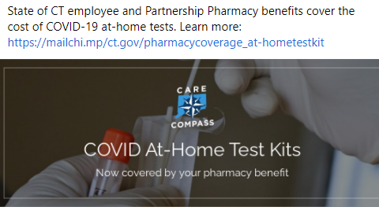

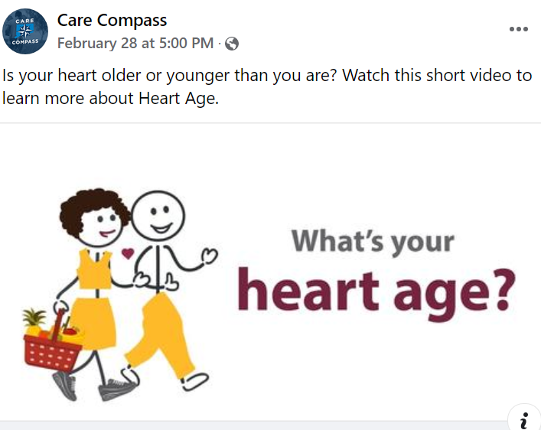


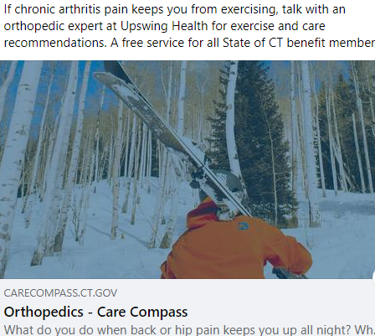
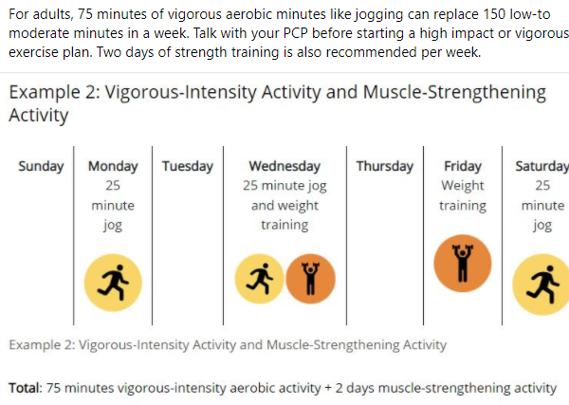
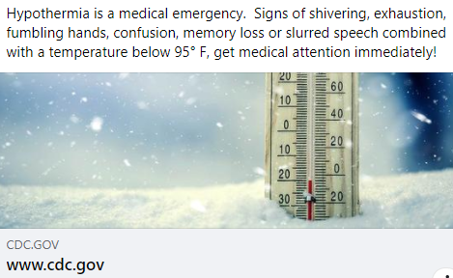
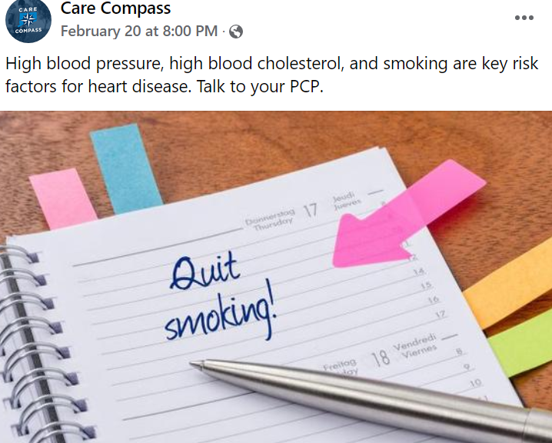
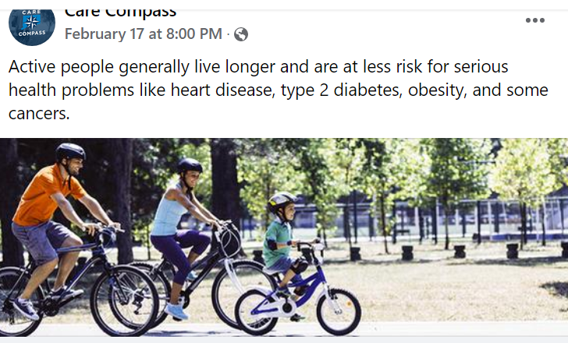

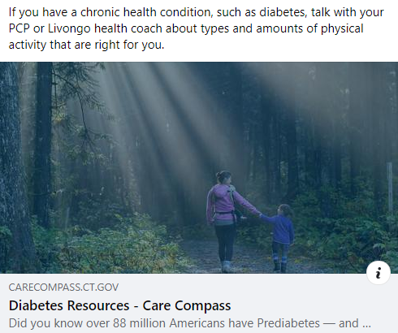
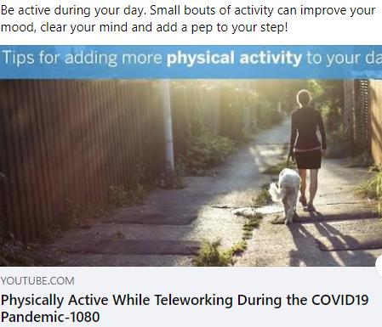
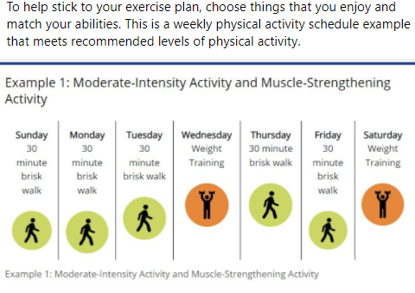

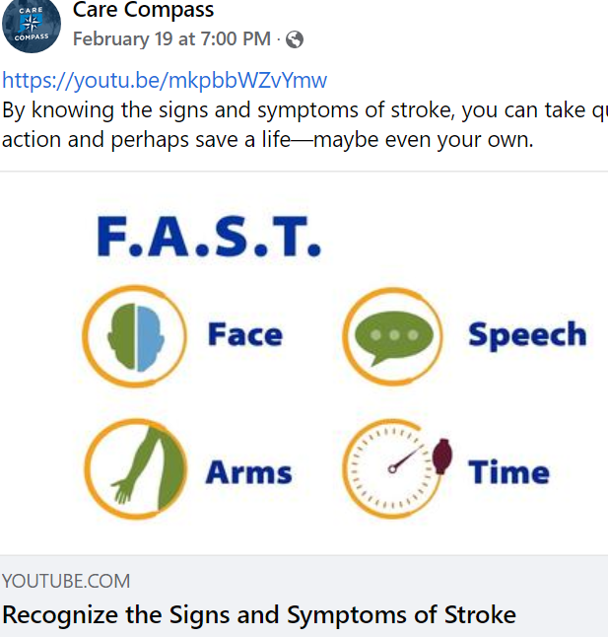
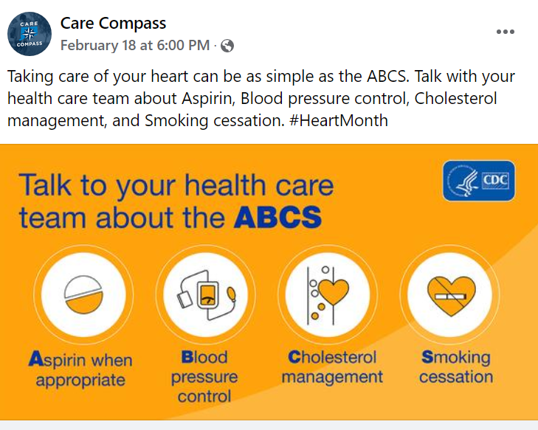
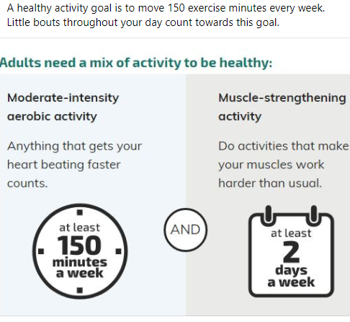

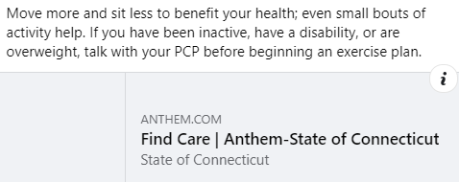
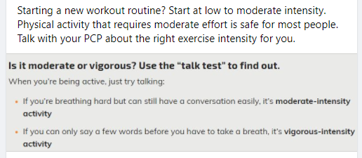
Social / Digital Content- Jan / Feb
OFFICE of the
STATE COMPTROLLER

Slide 9
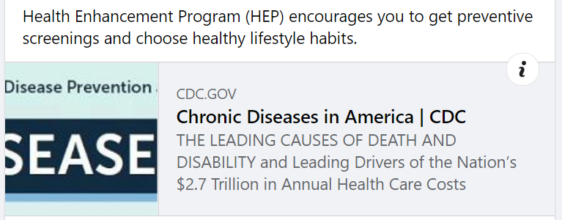
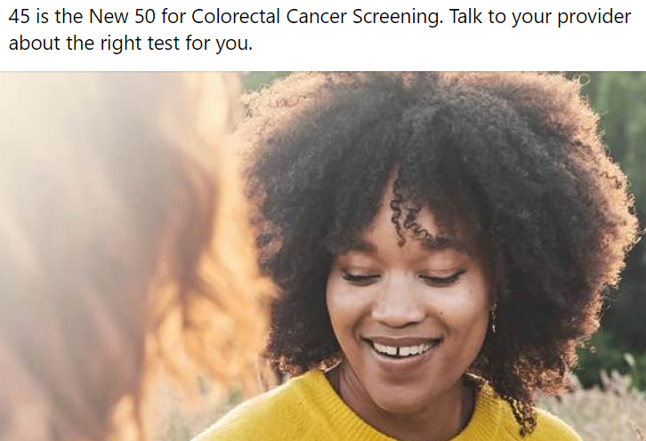
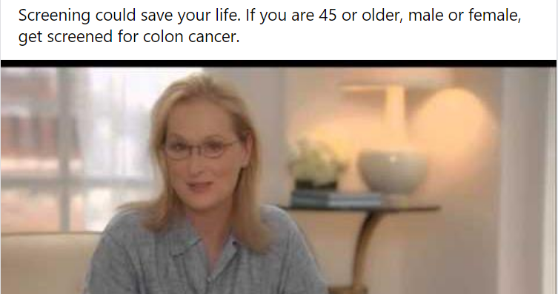
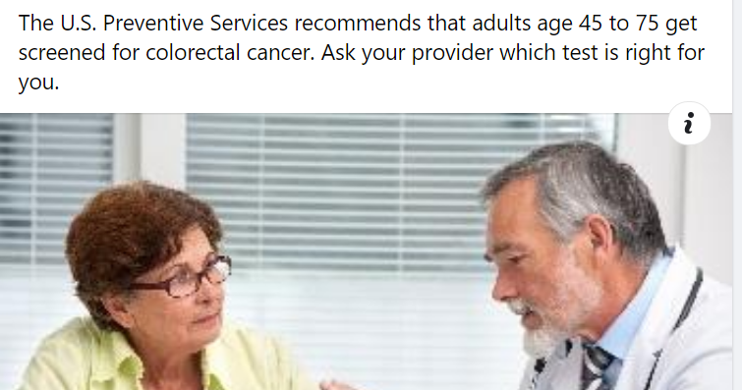
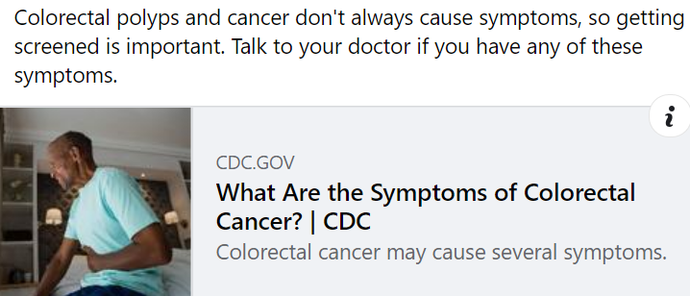
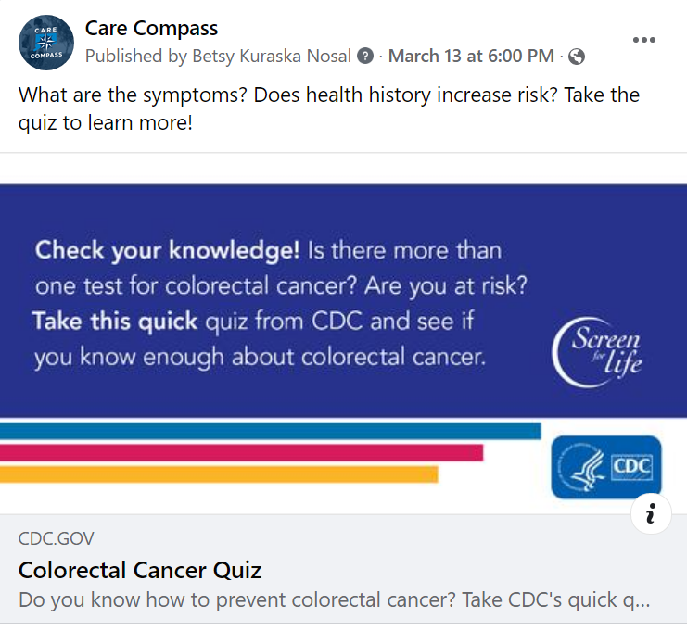
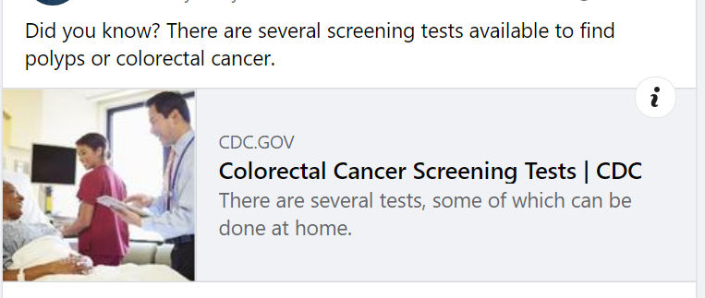
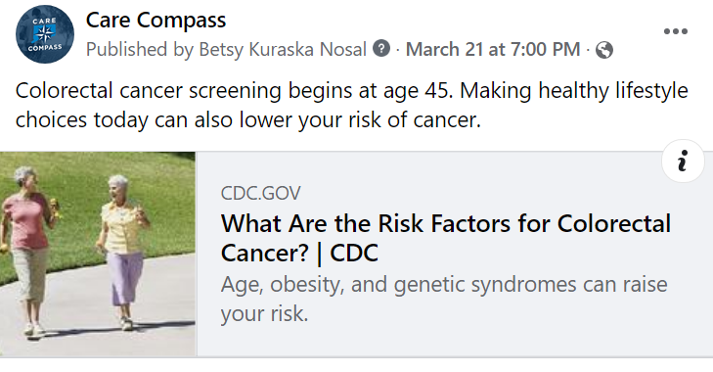
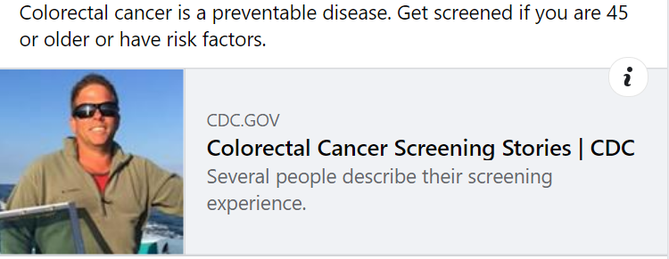
Social / Digital Content-March
OFFICE of the
STATE COMPTROLLER

Slide 10
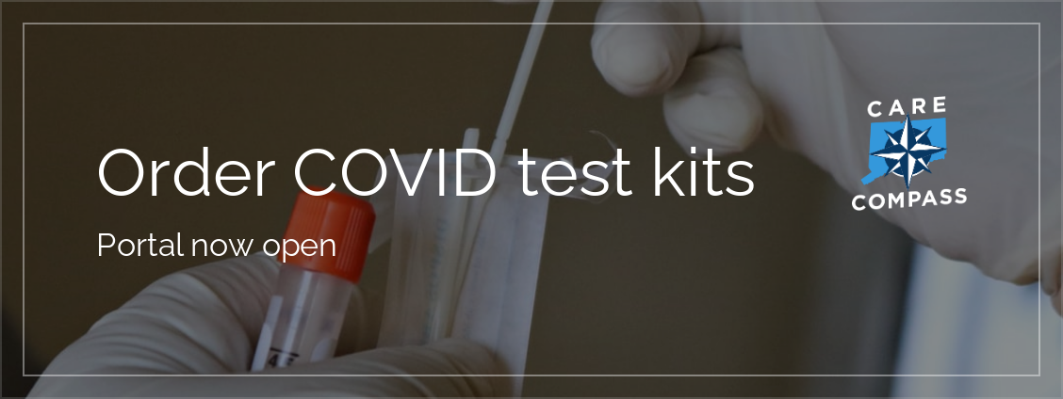

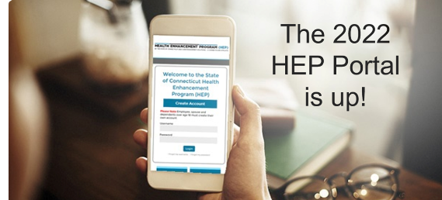
OFFICE of the
STATE COMPTROLLER
Email Communications
Email Topic | Sent | Audience | Total Reached | Total Opens* | Total Clicks* | Event Impact (unique) / Combined
Order COVID -19 test kits Federal Government - offering four tests per household | 1/18, 3pm | State email | 27,614 | 24,905 | 12,061 | 2,260 Order page 120 Carecompass page
CVS Pharmacy Benefit Coverage / Reimbursement process At-home test kits (8 tests per covered member per 30 days at $12 /test) | 1/24, 1pm 1/24, 2pm | State email Partnership email | 27,600 12,918 | 19,069 14,578 | 1,792 1,160 | Combined: 193 Caremark page 560 Reimbursement page 259 CareCompass page
CVS COVID Test Online Order and pick-up process | 2/18, 8 am | State email Partnership email | 27, 610 13,069 | 29,527 8,312 | 6,818 983 | 810 CVS.com page 190 CareCompass page 156 Ship-to-home page 138 Caremark/COVID page
Partnership Acquisition Campaign Group A (3 outreaches, including a mailer) | 1/11, 8am 2/1, 12pm | Email #1 (call outreach) Email #2 | 87 87 | 99 40 | 3 2 | 11 Direct appointments 7 Broker appointments
Partnership Acquisition Campaign Group B (3 outreaches, including mailer) | 2/18, 8am (3/14) | Email #1 (no follow-up calls) Email #2 (filtered to one content) | 93 46 | 135 31 | 13 1 | 2 groups responded
HEP Portal is Up | 3/7, 8am | State email | 27,416 | 16,625 | 9,926 | 2,473 HEP portal page 46 CareCompass page 13 CC Facebook page
*Opens and Clicks can include repeat activity by the same contact

Slide 11


Thank you.

Slide 12
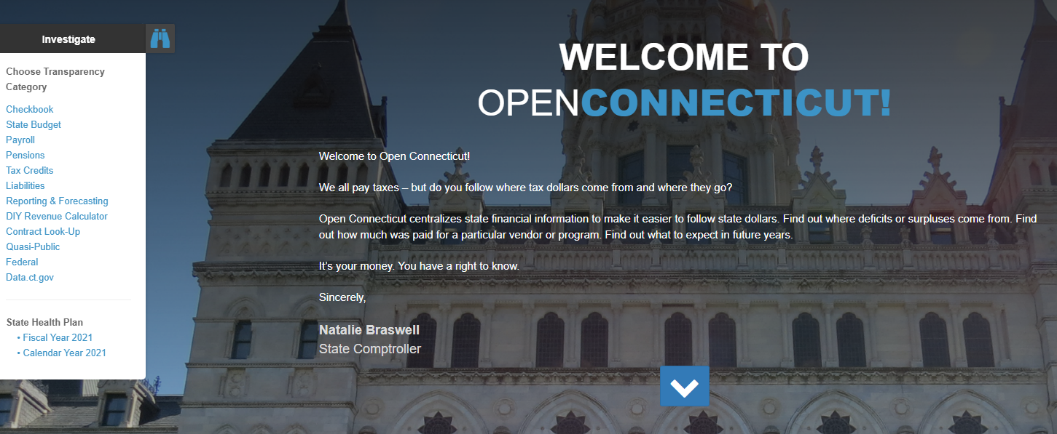
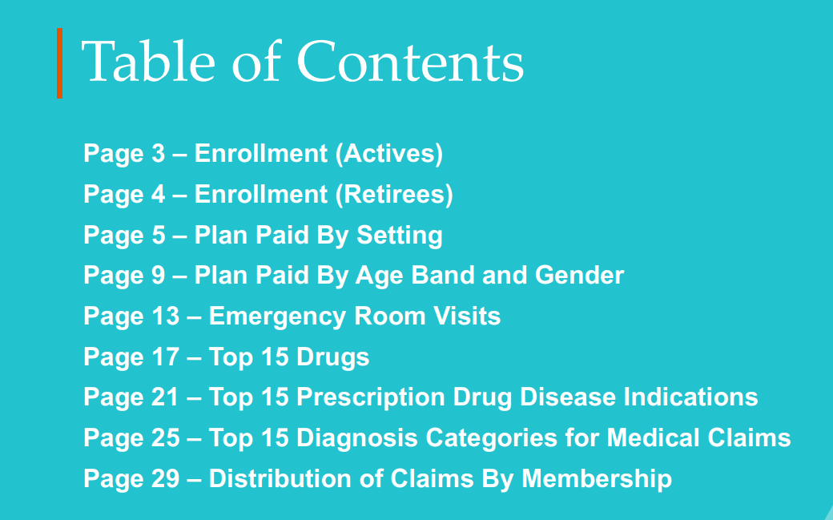
State Employee Plan and Partnership Plan Public Reporting:
Calendar Year 2021 Enrollment and Utilization Data Posted to Open Connecticut

Slide 13
OFFICE of the
STATE COMPTROLLER
Questions and Comments

Slide 14
OFFICE of the
STATE COMPTROLLER
Adjourn

