Slide 1


Health Care Update
November 8, 2021

Slide 2
OFFICE of the
STATE COMPTROLLER
Agenda
Status Updates
Public Comment
Financials/Budget Update (Rae-Ellen)
Partnership Update (Bernie)
Communications (Betsy)
Cigna Dental Report
Impact of removing A&S Pharmacy (Josh)
Contract Reimbursements (Josh)

Slide 3
OFFICE of the
STATE COMPTROLLER
Financials
FY 2021-2022 Year End Health Account Balances
Budget Review 10.15.21
Active Employee Healthcare Appropriation
Projected Appropriation Balance | $ 11,572,483.02
Active Employee Healthcare FAD Accounts
Projected Active Health FAD | $ 122,918,351.49
Projected Active Rx FAD | $ 40,270,907.77
Combined FAD Balances: | $ 163,189,259.25
Retired Employee Healthcare Appropriation
Projected Appropriation Balance | $ -11,742,616.46
Retired Employee Healthcare OPEB FAD Accounts
Projected Retiree Health | $ 128,745,003.30
Projected Retiree Rx | $ 39,584,225.79
Combined FAD Balances: | $ 168,329,229.09

Slide 4
Partnership
OFFICE of the
STATE COMPTROLLER
Partnership 2.0
As of 11/1/21 we still have 152 groups enrolled totaling almost 26,000 employees and over 63,000 members.
As of 11/1/21, we had 99 groups who have completed their 3-year contract commitment under Partnership and had the option of leaving the plan without an early termination penalty. To date, no group has left Partnership 2.0.
We have a small group confirmed to join on 12/1 as well as a potential small group joining on 1/1 and one on 2/1. There are also several large groups that are expressing interest for 7/1/22.

Slide 5

Communications Update
OFFICE of the
STATE COMPTROLLER
Presented by Betsy Nosal

Slide 6





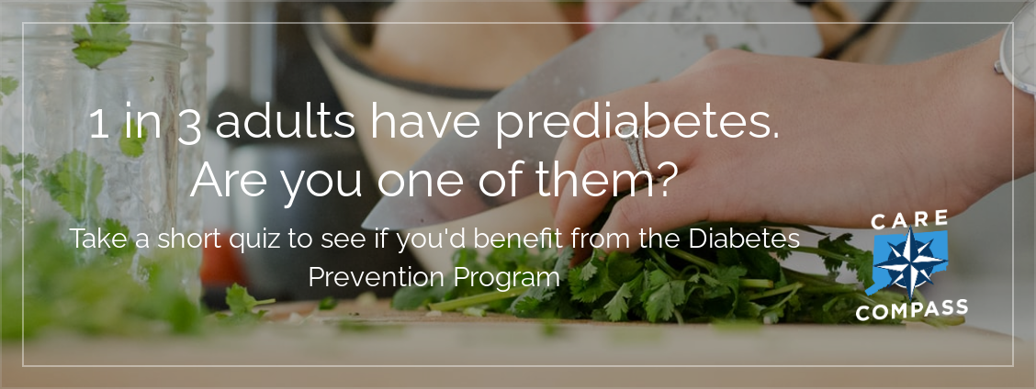
OFFICE of the
STATE COMPTROLLER
Email Communications
Email Topic | Sent | Audience | Reached | Opens | Clicks | Event Impact
Check HEP Status | 09/09/21 (Thurs) | -State email | 28,514 | 21,686 | 17,939 | 17,657 link clicks to HEP status page
Keep-in touch: follow on Facebook | 09/10/21 (Fri) | -Partnership member personal email | 13,037 | 7,607 | 225 | 177 link clicks to Carecompass Facebook page
Virtual Live Event: Orthopedic Resources* | 09/16/21 (Thurs); 9/21/21 (Tues) | -State work and personal email -SPP admins | 72,374 28.467 | 26,043 9.445 | 1,215 1,953 | 342 attendees; 100 chat questions
Online Focus Groups* | 09/29/21 (Wed) 10/04/21 (Mon) | -State work email -personal / work email | 28,387 34,290/28,446 | 5,703 10,332/480 | 366 156 / 35 | 4 group/events offered: 528 registered; 189 participated
Get Your Free Flu Shot | 10/06/21 (Wed) | -State email | 27,832 | 4,413 | 747 | 2,054 clicked on CareCompass/flu shot page
Virtual Live Event: HEP Q & A | 10/19/21 (Tue) | -State email | 28,598 | 5,261 | 1,287 | 405 attendees; 400 chat questions
Digital Diabetes Prevention Program | 10/25/21 (Wed) | -State email | 28,516 | 448 | 126 | 1,361 clicked on CDC prediabetes test; 151 CareCompass/ Diabetes page
*Email also shared with Agency benefit contacts to distribute to employees first.

Slide 7

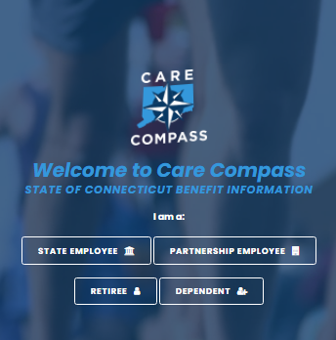
Care Compass Website & Google Ads
OFFICE of the
STATE COMPTROLLER
Note:
In October, we added HEP and Orthopedic ads; generating 120K and 47K impressions, respectively. These also increased our click rate (1K)
Unique Visitors include people who visited CareCompass this month, plus anyone who visited in the previous month and then returned this month. Only 1 visit is counted if someone visits multiple times in a month.
New Visits are total number of visits in the month.

Slide 8
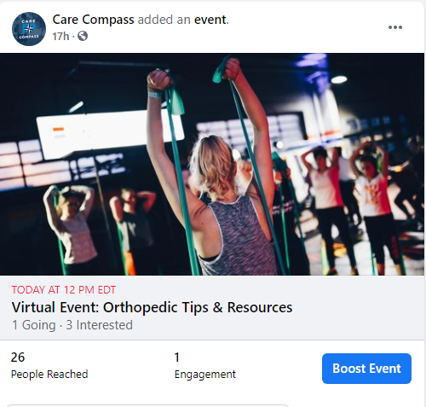
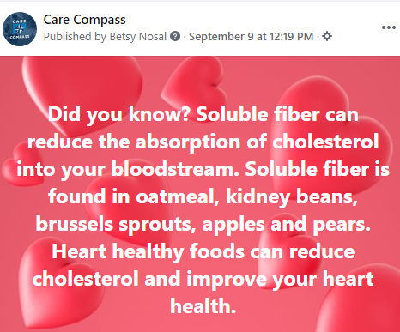
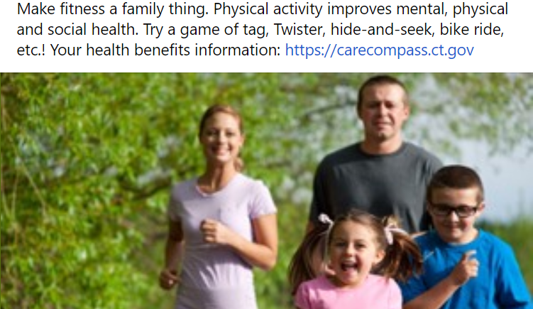
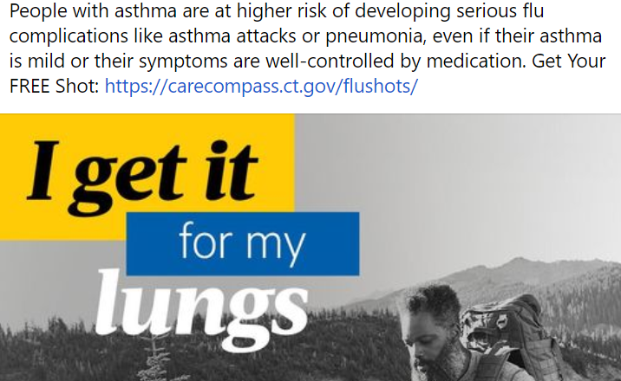
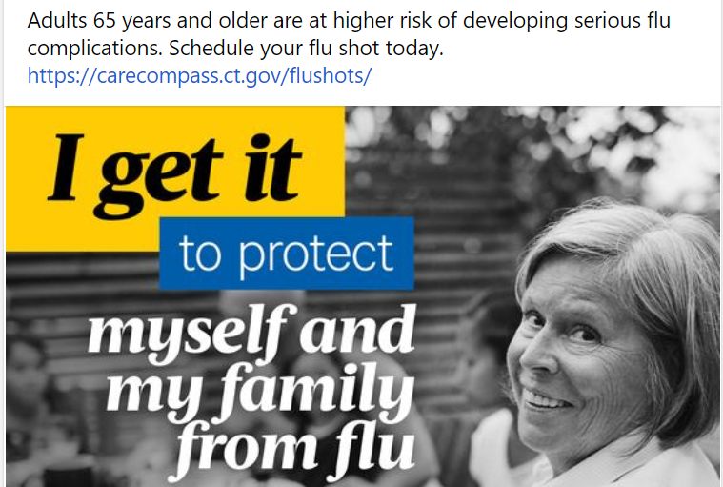


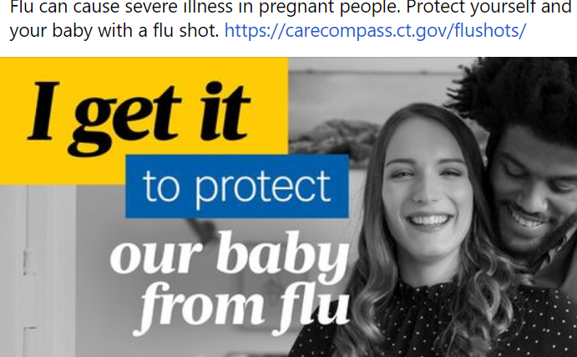
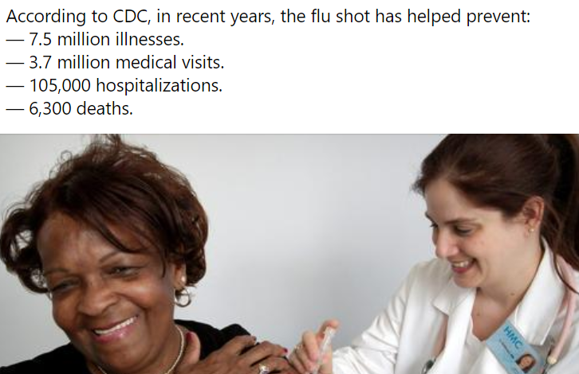
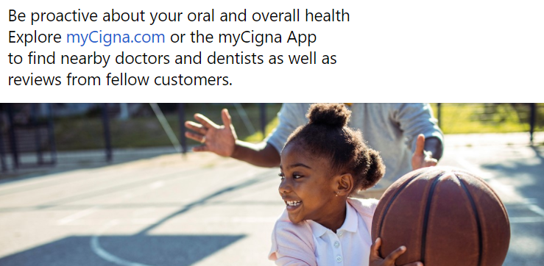
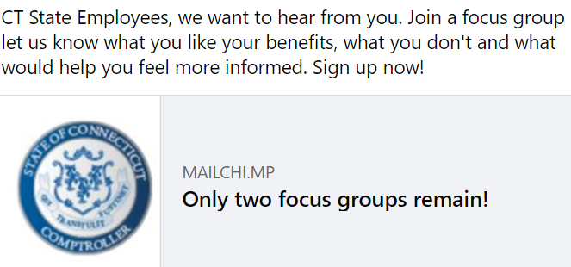
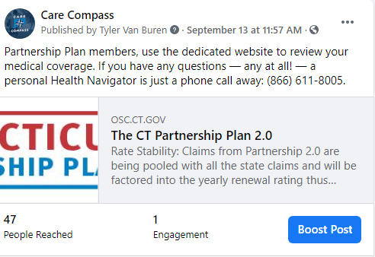
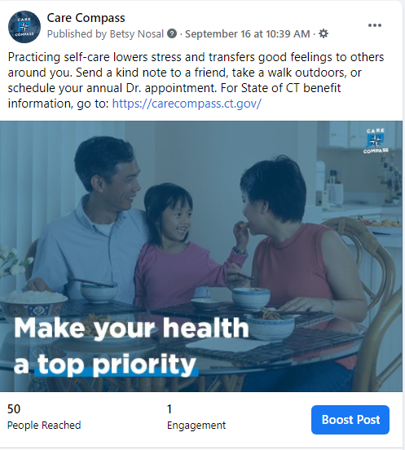
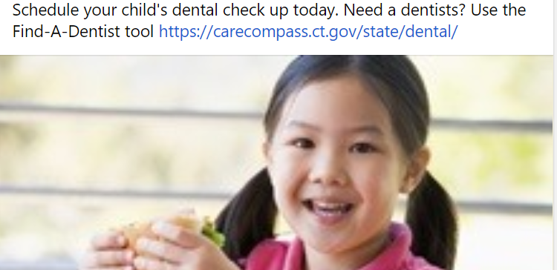
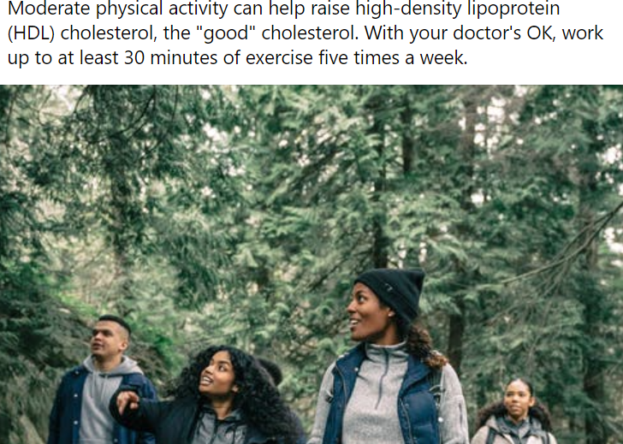
Social / Digital Communications
OFFICE of the
STATE COMPTROLLER
September: Cholesterol and Self-Care
October: Flu shot and Live Events
Events
Education
Benefit Programs

Slide 9
Member Education / Communication
OFFICE of the
STATE COMPTROLLER
Communication Plans (November- December)
State Member Education
  Email/all-users: Diabetes Live Event ; Preventive themed items including HEP reminder; Upswing ongoing webinars
  Mailer: Flu Postcard w/ QR code to Carecompass flu page; Generic Vs brand Rx in letter format
  Social (Facebook) Ads: HEP; FLU, Health Education (diabetes prevention/care, generic Rx,
  Digital (Google)
    Search) Ads: Continue with CT Health plan information, CareCompass, Orthopedic Injuries/ED avoidance
    Display Ads: Continue HEP and Orthopedic; add Diabetes (Livongo, DPP, chronic disease)
  Webinars: Diabetes Management Programs
    Agency contact and SPP Admin Webinar: teams, November 10, 11 am
    Member Webinar: Live Event, Nov 18th, Noon
Partnership Member Education
  Working with Anthem Communications team on the Partnership expansion campaign
  Fall health fairs scheduled; new 1 page flier handout created through Anthem Communications team
  Uploaded member emails to email platform from Anthem file and from SPP group administrators for us to begin SPP member benefits email campaigns.

Slide 10


State of Connecticut
HCC Meeting
November 2021

Slide 11
Cigna participants.
Brian Correia
Dental Sales Manager
Janine Pecott-Khongkham
Director of Dental Sales
Paul Sweeney
VP, Dental Growth & Strategy
Kellie Zappone
Senior Account Executive
Notes:
2020 National Market Message – finalist template

Slide 12

Agenda
Welcome and Introductions Paul Sweeney
Plan Performance & OHIP Janine Pecott
Customer Engagement Kellie Zappone
MyCigna Demo Brian Correia
Closing/Questions Paul Sweeney

Slide 13
Plan Performance & New Initiatives

Slide 14

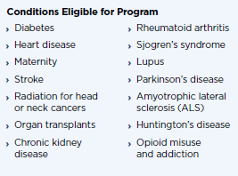
Program Updates & New Initiatives
PLAN PERFORMANCE HIGHLIGHTS
OHIP Expansion
Oral Health Integration Program (OHIP)
Membership Overview
Total members increased by 1% from 2019/2020 plan year (+1,936 lives)
1,792 members added to the DHMO 7/1/2021. DHMO overall enrollment:
  Total Care DHMO – 2,730
  Dental Care DHMO – 12,347
Doubled the number of covered conditions in 2021 (now 14)
NEW FOR 2021
Utilization & Cost Drivers
78.3% of enrollees are using the plan
New Total Care DHMO added for 7/1/2021
Strong network discounts & savings
HEP and Preventive Care Compliance
Highlights
OHIP Microsite
DHMO Tools & Resources

Slide 15
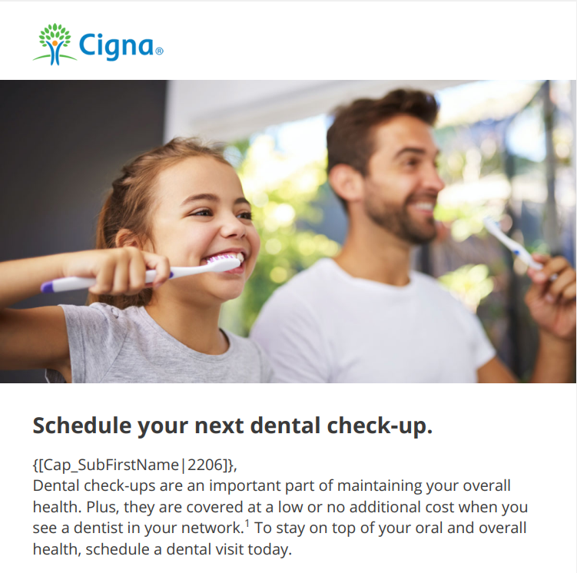
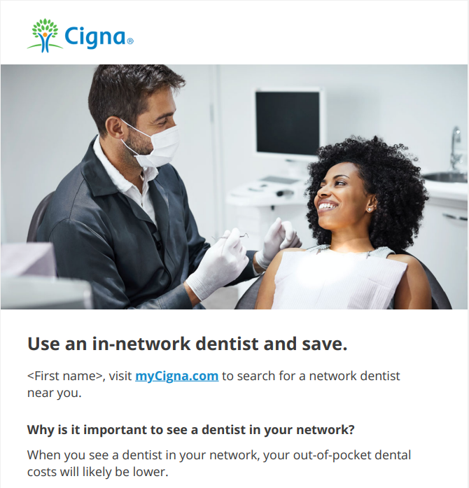
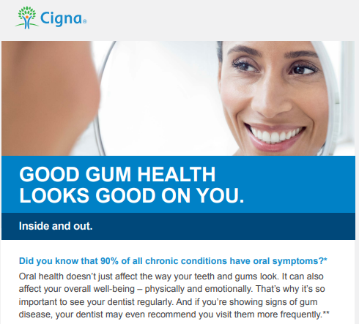
Customer Engagement
TARGETED ENGAGEMENT CAMPAIGNS

Slide 16
Engagement Tools & Resources

Slide 17
Engagement in the moment
24/7/365
myCigna® web/app Talk live Click to chat
Cigna Dental Health Connect®
Preventive care reminder
Compare ratings and read reviews*
Treatment Cost Estimator*
Decision support tools
Oral health assessments
Choose the right plan
Understand health risks
Find the right dentist
Learn ways to save
Improve whole health
*Actual features may vary by dentist and Cigna Dental plan type. These and other dentist directory features are for educational purposes only and should not be the sole basis for decision making. They are not a guarantee of the quality of care that will be delivered to individual customers. Customers are encouraged to consider all relevant factors and to speak with their treating dentist when choosing where to receive dental care.
Notes:
But just recognizing the opportunities to improve health through dental solutions is not enough. We need to engage and empower our customers in order to make it easy and affordable to get that dental care. Right from the moment they have an opportunity to choose a dental plan, we’re there to empower them with the information they need to make smart decisions. We have a personalized decision support tool that makes it easy for customers to choose the right plan for their needs when they are offered a choice between DPPO and DHMO. They can take short, simple assessments on their myCigna account to understand their risks – a lot of times people don’t even realize they are at risk for oral health problems. And when it comes to choosing which of our high-value, high-quality dentists to use for care, we make it easy with search tools on myCigna. They can read verified patient reviews, compare ratings that take into consideration affordability, professional history and patient experience and even see costs for hundreds of procedures specific to their plan and specific to each dentist in their network. And for those customers who may be at an even higher risk due to medical conditions like diabetes or pregnancy or heart disease, or who may have challenges getting care due to time, or limitations like COVID-19, we go a step further and connect them to programs built to solve for those challenges. We’ll go through some of these programs in more detail as we move through this presentation.
All of this support is designed to empower customers to get the information they need right when and where and how they need it – 24/7/365.

Slide 18


Find the right dentist
Decision support tools help make it easy
Members who recommend their dentist¹
95%
Cost and transparency
62%
Look up costs and procedures before your visit²
Customers who
use myCigna®
Have
save an average of 36.2%
8.6% more in-network claims³
on dental procedures³
Image for illustrative purposes only. 1. Cigna internal utilization data – average percentage of recommendations across network DPPO dentists by Cigna customers. As of October 2020. 2. myCigna Opinion Lab survey of Cigna Dental PPO customers. January 2018. 3. Cigna 7/2018 analysis of dental claims and myCigna.com activity between 2/1/17-4/30/18.
Confidential, unpublished property of Cigna. Use and distribution limited solely to authorized personnel. © 2020 Cigna
Notes:
Our decision support tools aren’t just an easy way to find a dentist. They can help drive meaningful savings on dental costs and connect customers to providers who offer quality care at a high value. Our network is built on partnerships with the right dentists in the right areas – where your employees need them most. We don’t just recruit to recruit. We select dentists who can provide high-value care. And with over 95% of customers saying they would recommend their network dentist to friends or family, we know our approach is the right one.
We also know our customers want to access information on costs before they go to the dentist. In fact, 62% of them look up costs and procedure information before they go for care. That’s why customers who use myCigna save an average of 36.2% more on dental procedures than customers who don’t use myCigna. These customers also have 8.6% more in-network claims – all of this translates to savings for you and for your employees.

Slide 19

Cigna Dental Virtual Care
Watch Video >
Dental care designed for our world.
Speak with a dentist 24/7/365¹ through myCigna:
Urgent care needs: Tooth pain, gum inflammation, broken teeth, infection
Non-narcotic medications and antibiotics prescribed
Guide follow-up care
Virtual consult costs on average:
17%
less than in-network
exam² and
48%
less than out-of-network exam²
Avoiding unnecessary
ER visits lowers costs:
$1,389
in potential savings³
Due to state laws governing access to virtual care, this service is not available to residents of Texas.
Percentages based on average cost for claims submitted in 2019 for in-network and out-of-network visits. Cigna internal reporting.
Internal reporting on average cost for ER claims submitted for dental-related concerns 2018-2019.
Cigna provides access to virtual care through national teledental care providers via myCigna.com. Providers are solely responsible for any treatment provided to their patients. Video chat may not be available in all areas or with all providers and is a requirement for this service. This service is separate from coverage for virtual dental care obtained through your regular dentist. A referral is not required for this service.
Notes:
Cigna Dental Virtual Care is our newest offering and its launch was accelerated when the COVID-19 pandemic really hit our country hard. But this solution goes beyond just enabling customers to access care while their own provider is closed or limiting hours due to the pandemic. It can have a meaningful impact on lowering your medical costs.
We all know that urgent dental concerns like a toothache, chipped tooth, infection and other oral health issues don’t always happen during regular dentist office hours. So when someone experiences one of these problems and they can’t get to their regular dentist for relief, they may end up at the emergency room. And those visits are costly. In fact, the average cost of a dental-related ER visit is $1,389.
But when customers can connect to a licensed dentist right when and where they need one, it can help eliminate the need for an expensive ER visit. Dentists can prescribe non-narcotic pain medications and antibiotics, and they can help guide care by letting their patient know when a situation is a true emergency that warrants a trip to the ER, or if it’s something that can wait until their dentist is available.
Virtual consults don’t just save on ER costs. They are, on average, 17% less expensive than an in-network exam and 48% less than an out-of-network exam. This makes Cigna Dental Virtual Care a convenient option for your employees and just one of the ways we’re helping our clients reduce costs for urgent and emergency dental care.

Slide 20
Closing/Questions

Slide 21

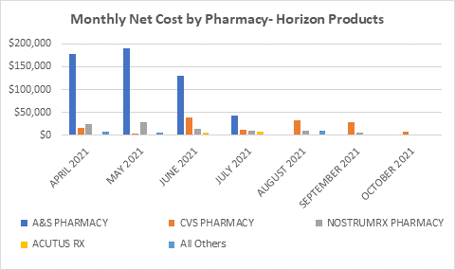



April-June= $645K Total Net Cost
July-October= $176K Total Net Cost
73% Reduction in Spend

Slide 22
Contractual Reimbursements
CVS
Specialty Acquisition Cost Pricing Reconciliation
$2.1 million
Generic Discount Guarantee Reconciliation
$2.5 million
CVS audit: Rebate Guarantees
$5.6 million (state plan)
$4 million (Partnership) – est. pending
Anthem
Medical Rebate Reconciliation
Invoiced: $3 million (2 quarters)
Received: $1.5 million (2 quarters)
Annualized State Revenue: $6 million
Missed Performance Guarantees (claims timeliness, time to answer)
$1 million

Slide 23
OFFICE of the
STATE COMPTROLLER
Questions and Comments

Slide 24
OFFICE of the
STATE COMPTROLLER
Adjourn

