Slide 1


Health Care Update
September 13, 2021

Slide 2
OFFICE of the
STATE COMPTROLLER
Agenda
Status Updates
Public Comment
Financials/Budget Update (Rae-Ellen)
Partnership Update (Bernie)
Communications (Betsy)
CVS Presentation

Slide 3
OFFICE of the
STATE COMPTROLLER
Financials
FY 2021-2022 Year End Health Account Balances
Budget Review 8.15.21
Active Employee Healthcare Appropriation
Projected Appropriation Balance | $ 6,874,274.24
Active Employee Healthcare FAD Accounts
Projected Active Health FAD | $ 148,694,611.06
Projected Active Rx FAD | $ 49,602,103.30
Combined FAD Balances: | $ 198,296,714.36
Retired Employee Healthcare Appropriation
Projected Appropriation Balance | $ -15,362,683.48
Retired Employee Healthcare OPEB FAD Accounts
Projected Retiree Health | $ 123,758,172.65
Projected Retiree Rx | $ 41,179,570.62
Combined FAD Balances: | $ 164,937,743.27

Slide 4
Partnership
OFFICE of the
STATE COMPTROLLER
Partnership 2.0
As of 9/1/21 there are 152 groups enrolled totaling almost 26,000 employees and over 63,000 members.
As of 9/1/21, we had 96 groups who have completed their 3-year contract commitment under Partnership and had the option of leaving the plan without an early termination penalty. To date, no group has left Partnership 2.0.
The Medical Loss Ratio for Fiscal Year July 2020 – June 2021 was 94.1%. Keep in mind that this includes IBNR reserves as well as the second half of our regional adjustment. Based on this, we anticipate a favorable MLR going forward into coming years.
Partnership 1.0
As of 9/1/21 we still have 5 groups remaining totaling approximately 2,400 employees and just under 3,400 members.

Slide 5

Communications Update
OFFICE of the
STATE COMPTROLLER
Presented by Betsy Nosal

Slide 6
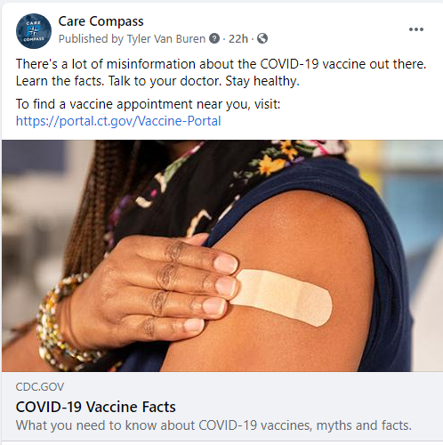
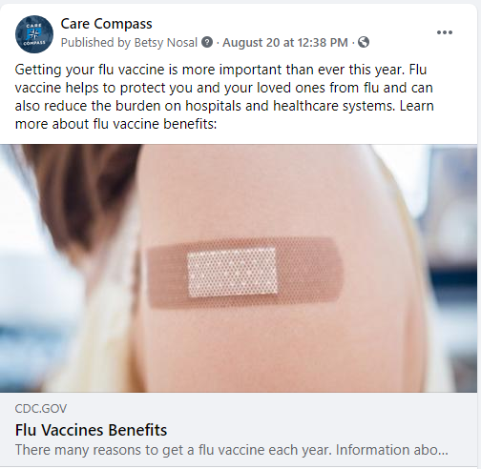
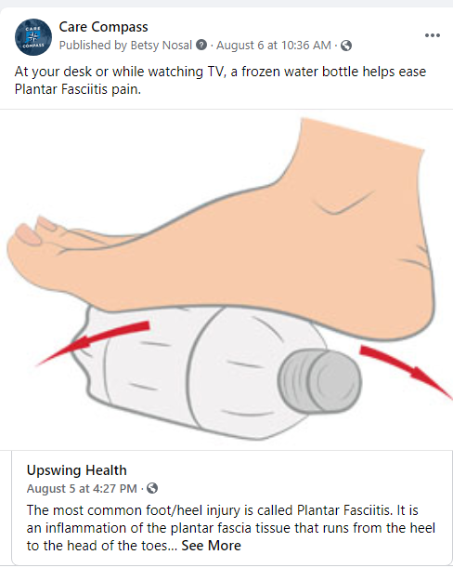
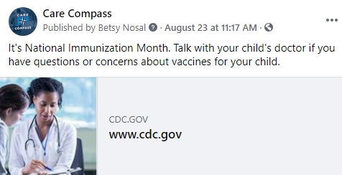
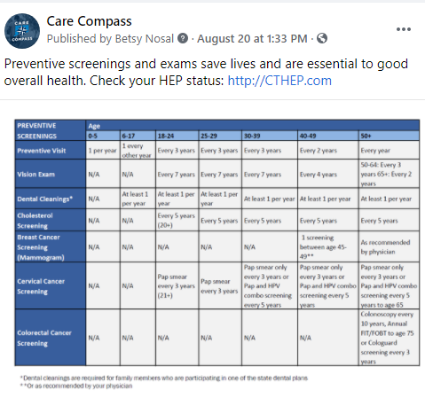
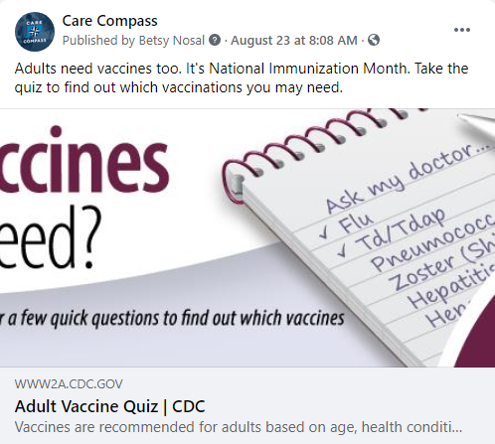
Social Media Ad Impact
OFFICE of the
STATE COMPTROLLER
Focus: Immunization and Prevention

Slide 7

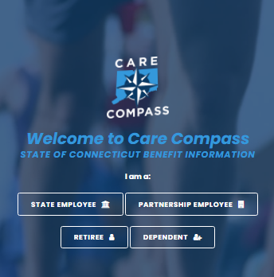
Care Compass Website & Google Activity
OFFICE of the
STATE COMPTROLLER
Unique Visitors include people who visited CareCompass this month, plus anyone who visited in the previous month and then returned this month. Only 1 visit is counted if someone visits multiple times in a month.
New Visits are total number of visits in the month.

Slide 8

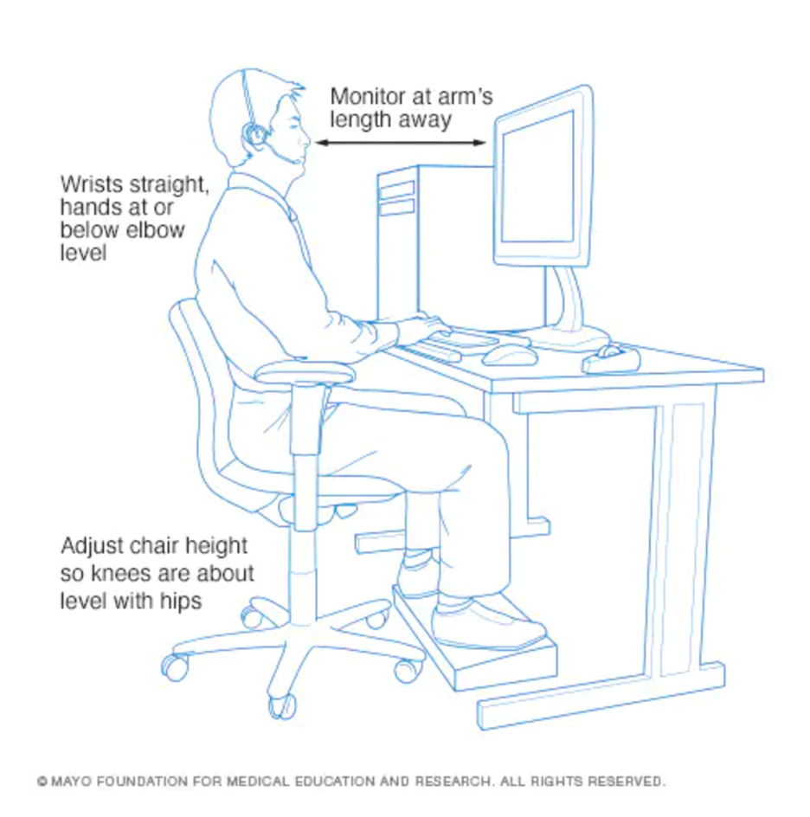


OFFICE of the
STATE COMPTROLLER
Email Impact
Physical self-check-ins / reminders (move, hydrate, take computer or work breaks).
Emotional self-check-ins / support (EAP, Live Health Online programs)
Chronic joint pain/care option using Upswing Health coaches or orthopedic symptom checker
Taking Care at Work | Taking Care at Work
Date Sent | August 5, 2021
Delivery | 29,116 | 93.4%
Email Opens | 7,670
Total Link Clicks | 466 | - CareCompass 54% - Upswing 33% - LiveHealth 13%
Unique Link Clicks | 110
Results as of September 2, 2021. Numbers can change when emails are opened later.

Slide 9
Member Education / Communication
OFFICE of the
STATE COMPTROLLER
Communication Plans (September-October)
State Member Education
  Email/all-users: Care Compass Facebook, support HEP compliance, Upswing Health (event)
  Social (Facebook) Ads: HEP; September Health Care topics: self-care and cholesterol awareness
  Digital (Google)
    Search) Ads: Continue with CT Health plan information, CareCompass, Orthopedic Injuries
    Display Ads: Begin HEP and Orthopedic to coincide with communications and events
  Member Webinar: Upswing Health on September 21st
Partnership Member Education
  Working with Anthem on Partnership expansion campaign
  Fall health fairs
  Collecting member email for direct to member email campaigns on benefits and program information

Slide 10


State of CT
Fiscal Year Highlights &
Clinical Program Savings
September 13, 2022
Local pasteboard textbox for sources — level 1 no bullet (copy and paste onto any slide pasteboard if needed; do not add to layouts or masters)
  Level 2 bullet

Slide 11
Agenda
FY21 State of Connecticut Key Metrics
State of Connecticut Clinical Program Savings

Slide 12
State of Connecticut – Fiscal Year 2021
4.4% Total Trend
        Non-Specialty Trend -6.6% , Specialty Trend 4.0%
        Key components of the State’s Overall Trend – Brand inflation (3.4% ) and change in drug mix (2.2%), offset by generics and decrease in total day supply
        Top drug classes contributing to trend – Dermatologicals, Vaccines, Respiratory Agents, Oncology, Migraine, Diabetes
        5 Diabetic drugs in the State’s Top 25 Non-Specialty drugs by cost
    4.0% Specialty Trend
        3.3% of total users driving 50.0% of State’s costs
        4,226 total users (Up 2.2%) , driving $130M in spend
        Average gross cost per specialty user - $30,597 , average age per user 48.2
        Top 5 classes contributing to specialty trend – Atopic Dermatitis, Oncology, Cystic Fibrosis , Psoriasis and Asthma
        70% filling specialty medications at CVS Specialty and/or CVS Pharmacy today
    Benchmark Comparisons:
        Brand drug utilization: 18.5% of total drug mix, up from 15.3%, significantly higher than Book of Business peers:
          Employer Peer : 14.2% / Government Peer: 13.4%
        Generic Dispensing : 80.5% of total generic scripts, down from 83.8.% , significantly lower than Book of Business peers.
          Employer Peer: 84.0.% / Government Peer: 85.1%
        Specialty: 2.0% of Total Rxs driving 50.0%.of plan costs
          Employer Peer: .9% of total prescriptions, / Government Peer: 1.3% of total prescriptions
    Program Successes - $29M in Rx Clinical Savings
52230
Source: RxInsights, 2020.
Notes:
Source: RxInsights, 2020.

Slide 13
FY21 Clinical Program Savings
Drug Savings Review
Concurrent and retrospective (with 72 hours) screening of prescription drug claims for age appropriateness, therapeutic alternatives, contraindications, optimal dose, duplicate therapy and optimal duration
Safety & Monitoring
Targets high risk drug classes, focusing on controlled substances, inappropriate and misuse such as multiple drug use, pharmacy & provider shopping, and high total controlled claims volume. Helps reduce fraud, waste and abuse through monitoring of monthly and quarterly claims and timely interventions
Utilization Management
Trend management strategy which includes Prior Authorization and Quantity Limits. Plan edits help ensure safe, effective, and appropriate utilization of selected drugs.
Specialty Guideline Management
Ensures appropriate utilization of specialty medications by using evidence-based criteria and high touch medical director review. Applies to (Rheumatoid Arthritis, Hepatitis C, IVIG, Fertility, Growth Hormone, Psoriasis classes only.
Pharmacy Advisor
Supports adherence, closes gaps in care, simplifies refills /renewals, Individualized outreach from CVS Health to patients with one of more of the 10 conditions, providing key messaging to influence adherence behavior
Rx Savings = $10.3M
Rx Savings = $302K
Rx Savings = $8.5M
Rx Savings = $9.9M
Health Savings = $14.5M (Rx and Medical)
Total Rx Plan Savings = $29M
Source : CVS Health Clinical Reporting Timeframe: 7/1/19-6/30/20

Slide 14
Prescription Safety
Management
Four pillars that work together to drive greater outcomes
Prevention
(UM Edits)
Identification
(Safety & Monitoring)
Intervention
(Safety & Monitoring)
Investigation
(Enhanced Safety & Monitoring)
  Messaging and hard
  or soft claim rejects alert pharmacists to possible unsafe use and includes opioid and controlled substance edits
  Identifies higher-risk members based on several factors, such as multiple prescribers/ pharmacies or excessive utilization
  Prescriber and member communications alerting to potential risk
  Extensive research with detailed course of action for complex member utilization patterns may include pharmacy follow-ups or prescriber consultations
Dynamic solutions that can help improve the safety and utilization of prescription drugs – including controlled substances
Resolution
Happens at any point in the process
52149
Image source: CVS Health Creative Resource Library, accessed 2019, 254606- GettyImages-606356789, no expiration GettyImages-1133885019.jpg
Notes:
For purposes of this discussion, we will be focusing on the activities that occur during the Safety and Monitoring and Enhanced Safety & Monitoring portion of the presentation.

Slide 15
Opioid utilization management
Helping decrease inappropriate opioid use while preserving access for those with genuine chronic pain needs
  To date, more than 2,000 clients accounting for more than 35 million lives have aligned with our opioid utilization management strategy
State of Connecticut Fiscal Year-Over-Year Compare
96%
Scripts for opioid-naïve patients are for a 7-day supply or less
30%
decline in number of scripts for > 200 MME/day
10%
decline in opioid
quantity and day supply per month
Source: CVS Health, RxNavigator and Opioid Dashboard, July-June 2021.
51392
Notes:
3769 over 90
49530 total
656 over 200 1.32
440 over 200
47594 total
3096 over 90
1. Stat ID: S1003490120 CVS Health Analytics, 2019. Book of Business data, excluding Medicare and Discount Card clients.
Analysis excludes LTC, Palliative Care and Cancer Patients. Q1‐2017 comparison to Q3‐2019.
Actual results may vary depending on benefit plan design, member demographics, programs
implemented by the plan and other factors. Client‐specific modeling available upon request
2. Stat ID: S1003460120 CVS Health Analytics, 2019. Book of Business data, excluding Medicare and Discount Card clients.
Analysis excludes LTC, Palliative Care and Cancer Patients. Q1‐2017 comparison to Q3‐2019 calculated
per 1000 eligible members. Actual results may vary depending on benefit plan design, member
demographics, programs implemented by the plan and other factors. Client‐specific modeling
available upon request.
3. Stat ID: S1003480120 CVS Health Analytics, 2019. Book of Business data, excluding Medicare and Discount Card clients.
Analysis excludes LTC, Palliative Care and Cancer Patients. Q1‐2017 comparison to Q3‐2019.
Actual results may vary depending on benefit plan design, member demographics, programs implemented
by the plan and other factors. Client‐specific modeling available upon request.
The source for data in this presentation is CVS Health Enterprise Analytics unless otherwise noted. Please see the disclaimer page at the end of this presentation for more information.

Slide 16

Safety and Monitoring Solutions
State of CT Case Study
Male, 52, Crohns disease, urological condition, anxiety
Overview of Referral
  Male, age 52 w/diagnosis of crohns disease, urological condition, anxiety
  Identified by SMS and referred into ESMS due to use of multiple prescribers and multiple targeted medications
  Combination therapy increases risk of adverse events
Outcome
Coordination of care letters were sent to all prescribers along with a summary of the patient’s prescription history
ESMS monitored case for several months
Reduction in number of:
  Prescribers of targeted medications; reduced from 10 to 2
  Targeted drugs; reduced from 5 to 1
  Current regimen includes low-dose anxiety medication, occasional use of low dose, short-acting opioids
52149
Image source: CVS Health Creative Resource Library, accessed 2019, 157270_GettyImages-595347235, no expiration
Notes:
Slide objective: Provide an example patient profile to illustrate how the core safety and monitoring solution works.
Key Points:
In this patient profile the member has long-term pain management in place to address a chronic condition.
Surgeries addressing other chronic or acute problems can result in additional pain medications.
It is likely that the patient is unaware of the potential danger of combining multiple pain killers.
It is likely that the patient’s prescribers are unaware of the conflicting prescriptions prescribed.
Core safety and monitoring reduces member risk and decreases prescription costs.
Notes:
Core safety and monitoring is structured to identify and rectify cases of accidental overuse. It’s easy for an individual with multiple conditions to end up with overlapping prescriptions. Our program helps protect individuals from overdose (and hospitalization) and can reduce drug costs.

Slide 17
Legal disclaimers
The source for data in this presentation is CVS Health Enterprise Analytics unless otherwise noted.
All data sharing complies with applicable law, our information firewall and any applicable contractual limitations.
Adherence and health outcome results, savings projections and performance ratings are based on CVS Caremark data. Actual results may vary depending on benefit plan design, member demographics, programs implemented by the plan and other factors. Client-specific modeling available
upon request.
The Maintenance Choice program is available to self-funded employer clients that are subject to ERISA. Non-ERISA plans such as fully insured health plans, plans for city, state or government employees and church plans need CVS Caremark legal approval prior to adopting the Maintenance Choice program. Prices may vary between mail service and CVS Pharmacy due to dispensing factors, such as applicable local or use taxes.
Specialty Expedite is available exclusively for providers who use compatible electronic health record (EHR) systems, including Epic Systems and others that participate in the Carequality Interoperability Framework.
Specialty delivery options are available where allowed by law. In-store pick up is currently not available in Oklahoma. Puerto Rico requires first-fill prescriptions to be transmitted directly to the dispensing specialty pharmacy. Products are dispensed by CVS Specialty and certain services are only accessed by calling CVS Specialty directly. Certain specialty medication may not qualify. Services are also available at Long’s Drugs locations.
Patient stories and patient names are presented for illustrative purposes only. Any resemblance to an actual individual is coincidental. Unless otherwise specified, images contained within are licensed or the property of CVS Health or one of its affiliates.
This presentation contains trademarks or registered trademarks of CVS Pharmacy, Inc. or one of its affiliates; it may also contain references to products that are trademarks or registered trademarks of entities not affiliated with CVS Health.
52149

Slide 18
OFFICE of the
STATE COMPTROLLER
Questions and Comments

Slide 19
OFFICE of the
STATE COMPTROLLER
Adjourn

