Slide 1


Health Care Update
August 9, 2021

Slide 2
OFFICE of the
STATE COMPTROLLER
Agenda
Status Updates
Public Comment
Financials/Budget Update (Rae-Ellen)
Partnership Update (Bernie)
  July 1 contingent launch for BC Prime (Tom)
Communications (Betsy)
UHC Presentation

Slide 3
OFFICE of the
STATE COMPTROLLER
Financials
FY 2020-2021 Year End Health Account Balances
Budget Review FY21 Year End
Active Employee Healthcare Appropriation
Final Appropriation Balance | $ 40,442,766.44
Active Employee Healthcare FAD Accounts
Final Active Health FAD | $ 151,461,023.99
Final Active Rx FAD | $ 49,106,710.80
Combined FAD Balances: | $ 200,567,734.79
Retired Employee Healthcare Appropriation
Final Appropriation Balance | $ 97,767,101.90
Retired Employee Healthcare OPEB FAD Accounts
Final Retiree Health | $ 114,201,687.30
Final Retiree Rx | $ 84,054,109.17
Combined FAD Balances: | $ 198,255,796.47

Slide 4
OFFICE of the
STATE COMPTROLLER
Financials
FY 2021-2022 Projected Health Account Balances
Budget Review FY21 Year End
Active Employee Healthcare Appropriation
Initial Anticipated Spend | $ 710,674,000.00
Appropriation Value | $ 711,164,645.00
Difference | $ 490,645.00
Retired Employee Healthcare Appropriation
Initial Anticipated Spend | $ 738,011,000.00
Appropriation Value | $ 835,776,101.90
Difference | $ 97,765,101.90

Slide 5
Partnership
OFFICE of the
STATE COMPTROLLER
Partnership 2.0
As of 8/1/21 there are 151 groups enrolled totaling almost 26,000 employees and over 63,000 members.
As of 8/1/21, we had 95 groups who have completed their 3-year contract commitment under Partnership and had the option of leaving the plan without an early termination penalty. To date, no group has left Partnership 2.0.
We have 1 small group confirmed joining the plan for 9/1/21.
Partnership 1.0
As of 8/1/21 we still have 5 groups remaining totaling approximately 2,400 employees and just under 3,400 members.

Slide 6
BC Prime - Partnership
Recommending July 1, 2022 roll-out to Partnership
Recommendation contingent upon analysis indicating BC Prime performing as anticipated
  Initial analysis of 5 months of claims shows reduction in PMPM for participating members vs. prior period
OSC will make final recommendation in January 2022 allowing participating groups adequate time to introduce new plan option.

Slide 7

Communications Update
OFFICE of the
STATE COMPTROLLER
Presented by Betsy Nosal

Slide 8
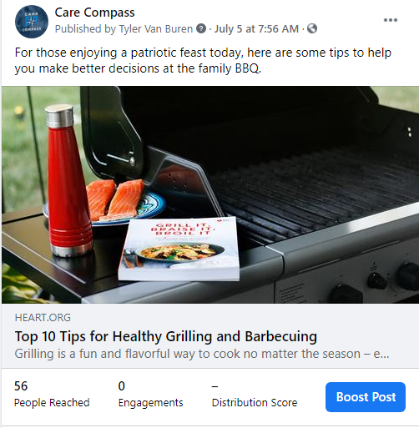

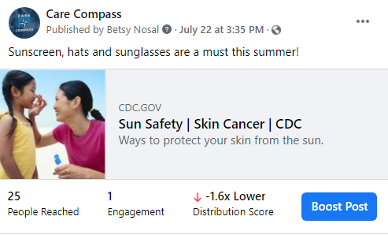
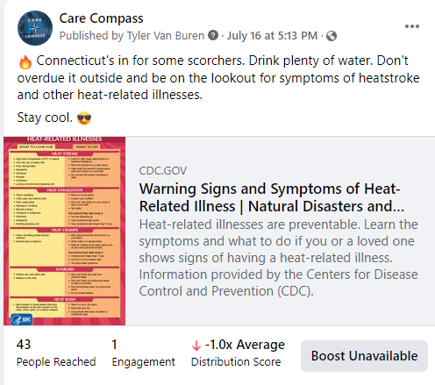
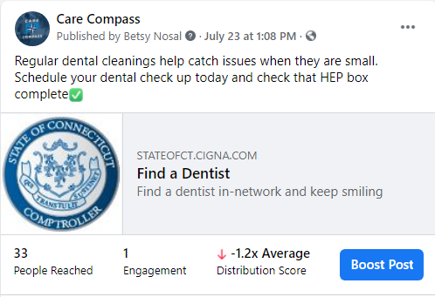
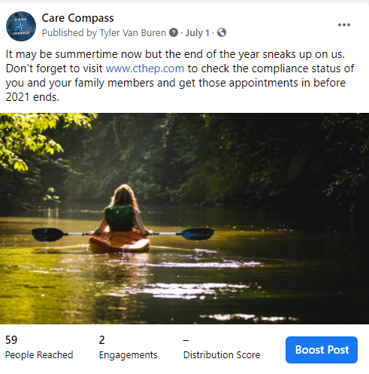
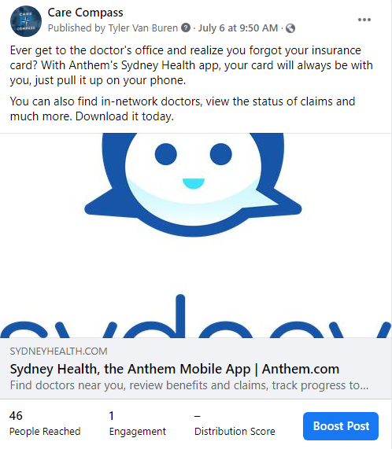
Social Media Ad Impact
OFFICE of the
STATE COMPTROLLER

Slide 9
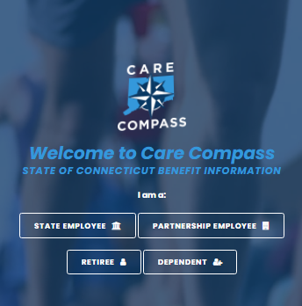
Care Compass Website Activity
OFFICE of the
STATE COMPTROLLER
Unique Visitors include people who visited CareCompass this month, plus anyone who visited in the previous month and then returned this month. Only 1 visit is counted if someone visits multiple times in a month.
New Visits are total number of visits in the month.

Slide 10




OFFICE of the
STATE COMPTROLLER
Educating Agency Benefit Leads
Meeting: July 29, 2021, 1 PM
Presenters: Upswing Health, Signify Health and Health Advocate
Over 110 benefit contacts invited, 60 attended
Q & A segment at end of three presentations
On-demand recording, and deck sent to all contacts post event

Slide 11
Member Education / Communication
OFFICE of the
STATE COMPTROLLER
Communication Plans (August-September)
State Member Education
  Email: “Take Care at Work” all-user email (desk ergonomics, Live Health Online, desk stretch breaks)
  Email: Promote Care Compass Facebook
  Email and Facebook (Social) Ad: Comprehensive Spine, HEP and approved wellness topics
  Email and (Digital / Search) Ad: Diabetes Prevention Program (DPP) and Livongo
  Member-facing Webinar: Upswing Health
Partnership Member Education
  Working with Anthem on expansion campaign
  Fall health fairs
  Continue to collect member email for direct to member email campaigns on benefits and program information

Slide 12


Slide 13


Slide 14
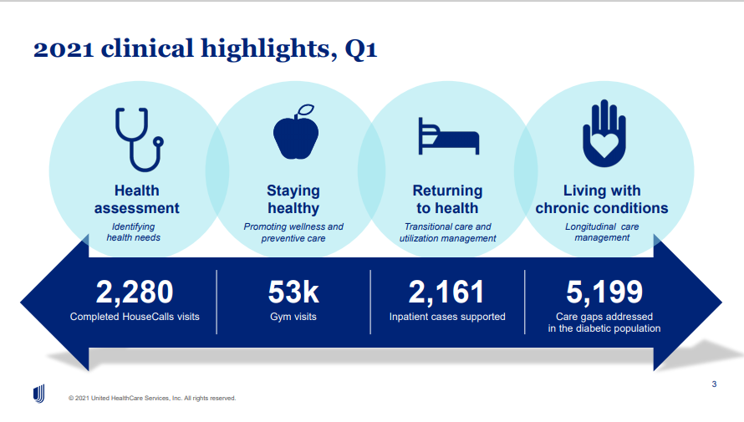

Slide 15
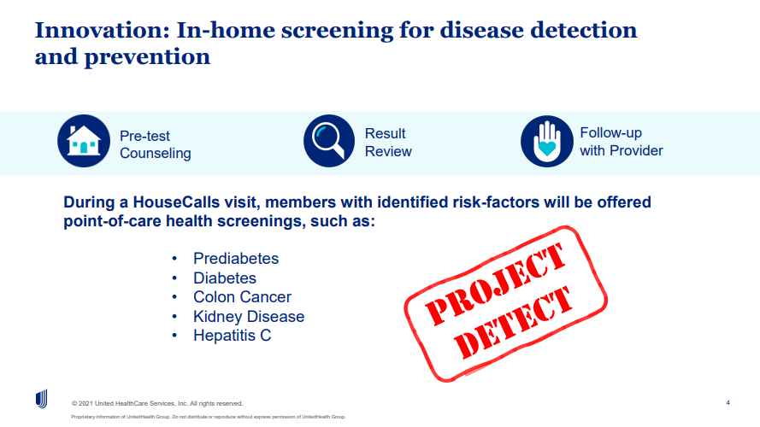

Slide 16
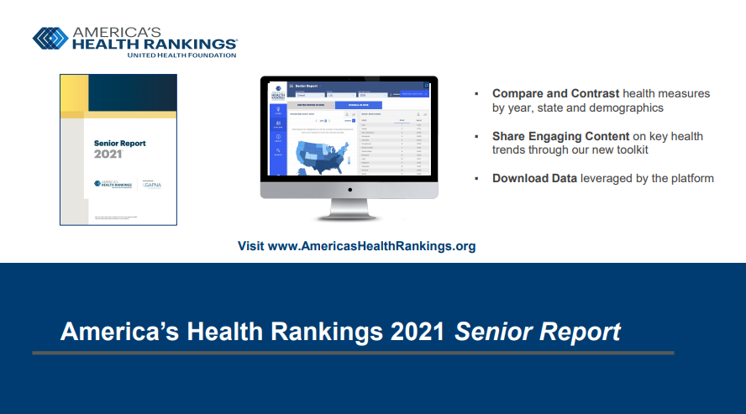

Slide 17
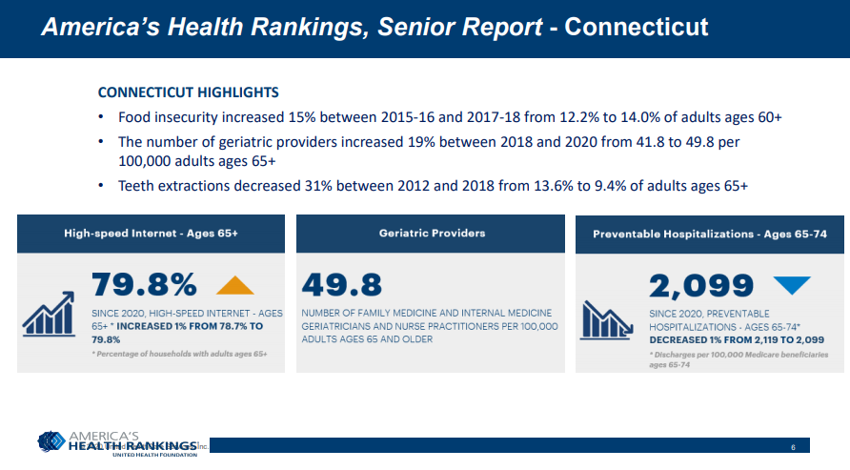

Slide 18
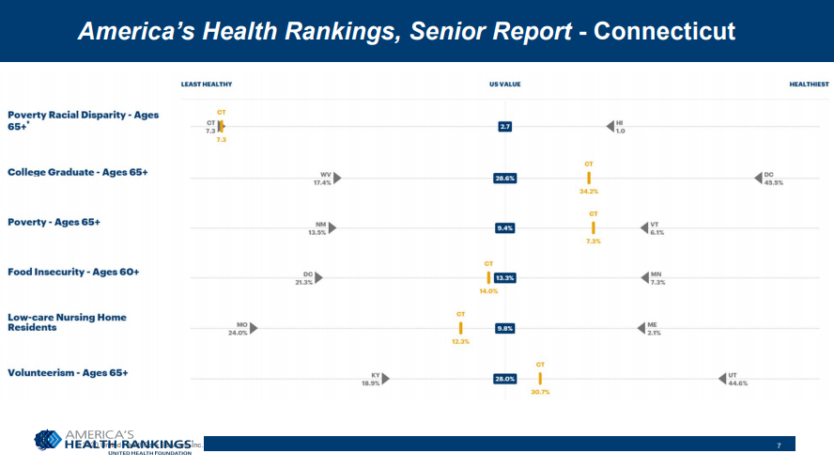

Slide 19


Slide 20
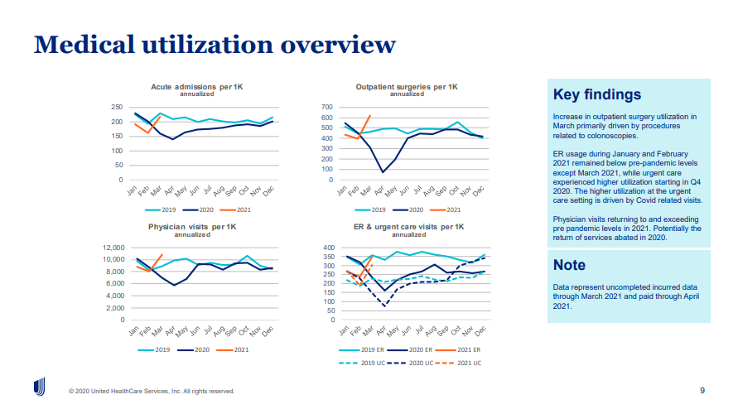

Slide 21
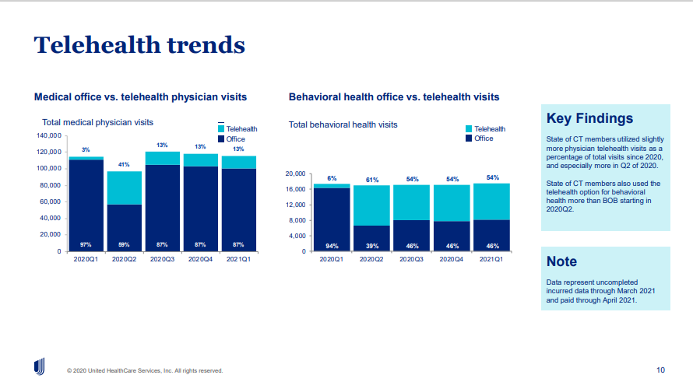

Slide 22
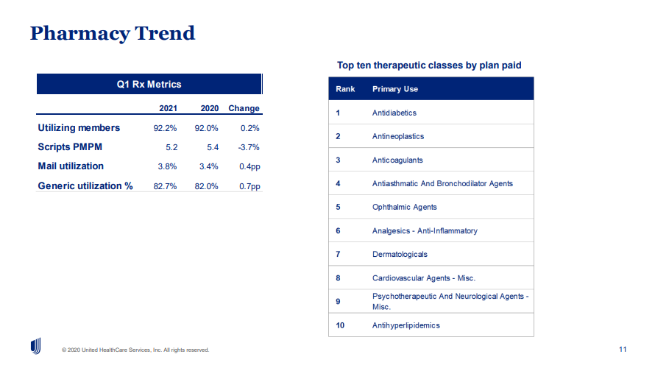

Slide 23


Slide 24
OFFICE of the
STATE COMPTROLLER
Questions and Comments

Slide 25
OFFICE of the
STATE COMPTROLLER
Adjourn

